Slide 1

BLEEDING CONTROL Course
American College of Surgeons
BLEEDINGCONTROL.ORG
SAVE A LIFE
Copyright © 2019 American College of Surgeons
Version 2
BLEEDINGCONTROL.ORG
STOP THE BLEED® is a registered trademark of the U.S. Department of Defense

Slide 2












Bleeding Control is a collaborative effort by:
The Hartford
Consensus Group
The American
College of Surgeons Committee on Trauma
The Committee on Tactical Combat Casualty Care
The National Association of
Emergency Medical Technicians
< >

Slide 3
WARNING! Some of the images shown during this presentation are graphic and may be disturbing to some people.

Slide 4
Why Do I Need This Training?
The #1 cause of preventable death
after injury is bleeding.

Slide 5




Where Can I Use This Training?

Slide 6
Goals
1. Identify
Recognize
life-threatening bleeding
Stop the Bleeding
Take steps to
STOP THE BLEEDING
  Pressure
✓ Packing
✓ Tourniquets

Slide 7
Personal Safety
YOUR safety is YOUR first priority
If you are injured, you cannot help others
Help others only when it’s safe to do so
If the situation changes or becomes unsafe:
✓ Stop
✓ Move to safety
✓ If you can, take the victim with you

Slide 8
Personal Safety
YOUR safety is YOUR first priority
Wear gloves if you can
If you get blood on you, be sure to clean any part of your body that the blood has touched
Tell a health care provider that you got blood on you, and follow his or her direction

Slide 9
ABCs of Bleeding Control
A Alert 111
B Bleeding
C Compress

Slide 10
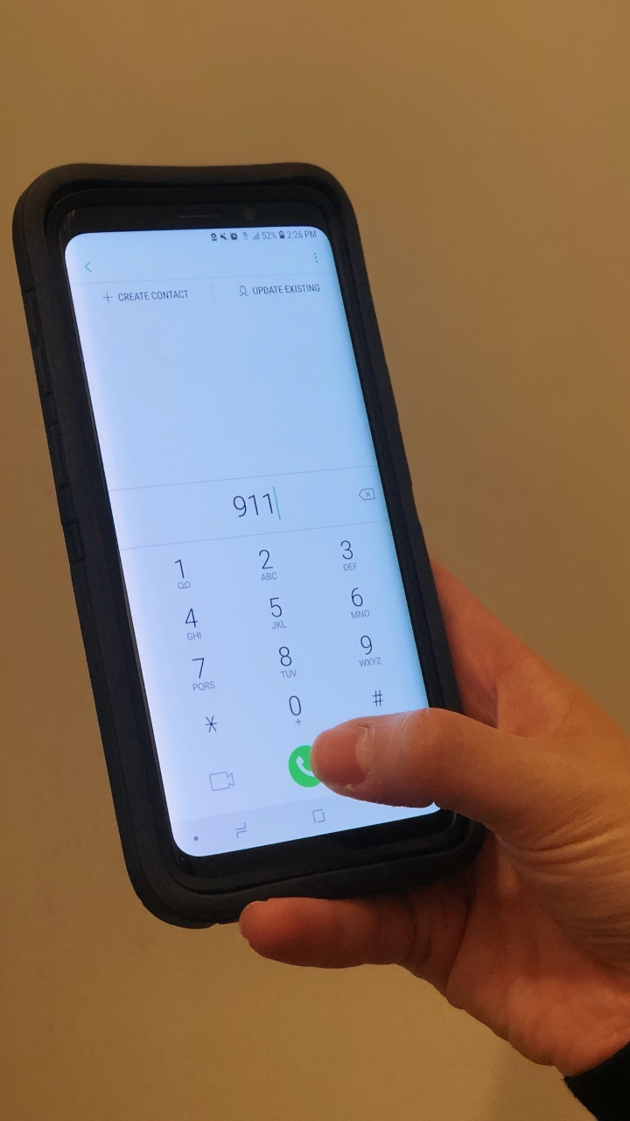
ABCs of Bleeding Control
A Alert 111
B Bleeding
C Compress

Slide 11
ABCs of Bleeding Control
A Alert 111
Call 111
Know your location
Follow instructions provided by 111 operator

Slide 12
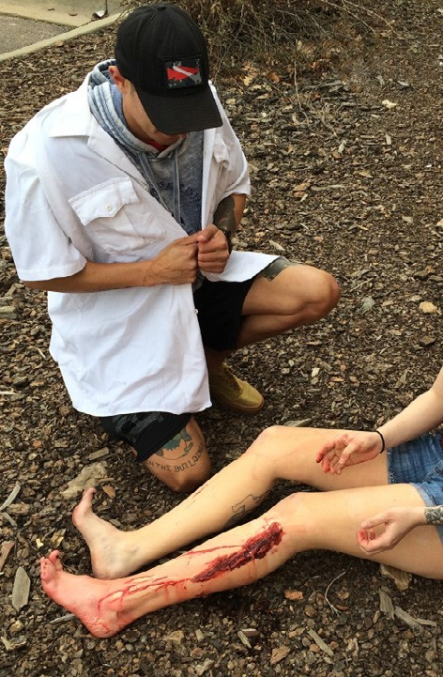
ABCs of Bleeding Control
A Alert 111
B Bleeding
C Compress

Slide 13
ABCs of Bleeding Control
B Bleeding
Find source of bleeding
Look for:
  Continuous bleeding
  Large-volume bleeding
  Pooling of blood

Slide 14
ABCs of Bleeding Control
B Bleeding
There may be multiple places the victim is bleeding
Clothing may also hide
life-threatening bleeding

Slide 15
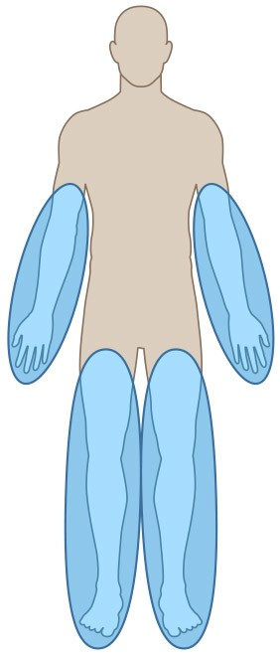
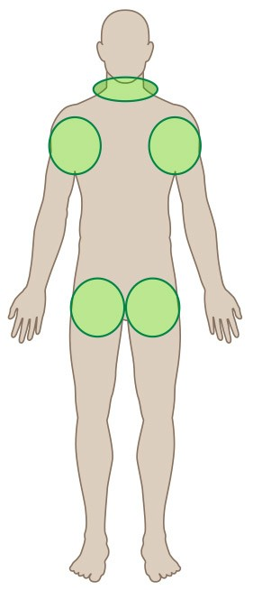
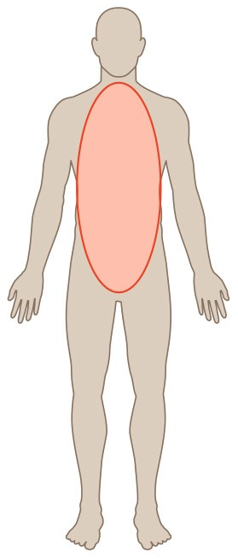
ABCs of Bleeding Control
B Bleeding
Arms and legs
Neck, armpits,
and groin
Body

Slide 16
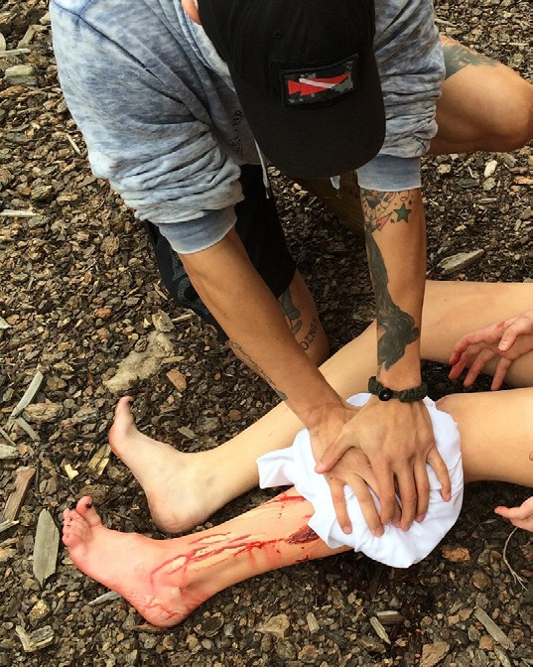
ABCs of Bleeding Control
A Alert 111 B Bleeding
C Compress - Pressure

Slide 17
ABCs of Bleeding Control
C Compress - Pressure
Apply direct pressure to wound
Focus on the location of the bleeding
Use just enough gauze or cloth to cover injury
If pressure stops the bleeding, keep pressure on wound until help arrives

Slide 18
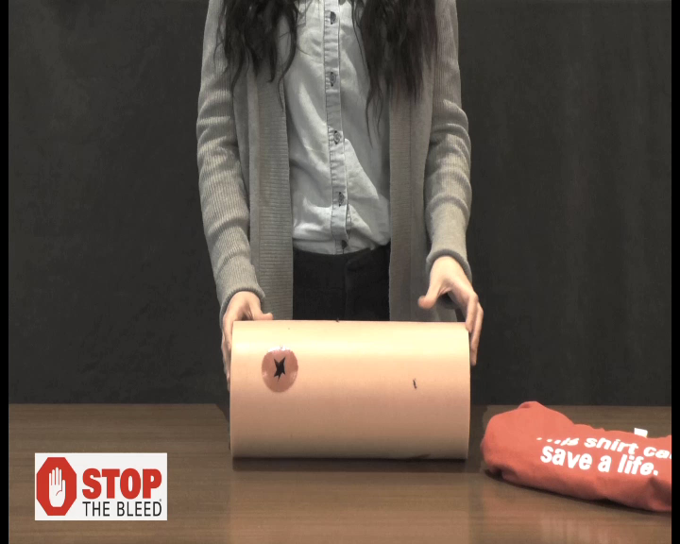

ABCs of Bleeding Control

Slide 19
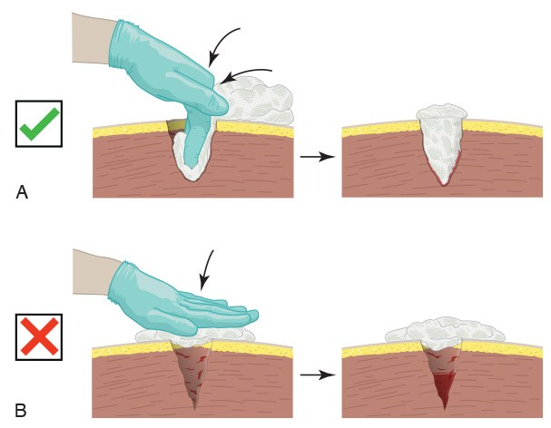
ABCs of Bleeding Control
C Compress - Packing
For large wounds, superficial
pressure is not effective
If bleeding is from a deep wound, pack gauze tightly into the wound until it stops the bleeding; hold pressure until help arrives

Slide 20
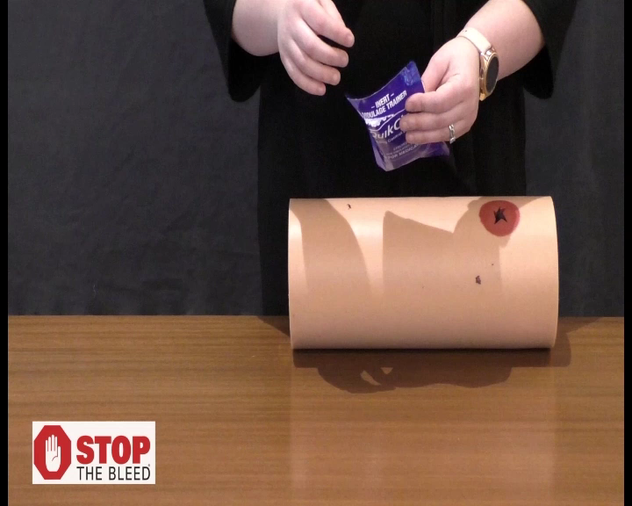
ABCs of Bleeding Control

Slide 21
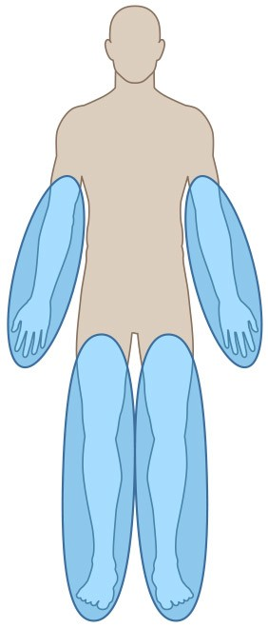
ABCs of Bleeding Control
C Compress - Packing
Arms and legs
Neck, armpits,
and groin
Body

Slide 22
ABCs of Bleeding Control
C Compress - Tourniquet
Apply 2 to 3 inches above wound
Do not place over the elbow or knee
Tighten tourniquet until bleeding stops
Do NOT remove the tourniquet

Slide 23
ABCs of Bleeding Control
C Compress - Tourniquet
Can apply to others or on yourself
Can be applied over clothes
Tourniquets HURT
A second tourniquet may be required to stop the bleeding

Slide 24
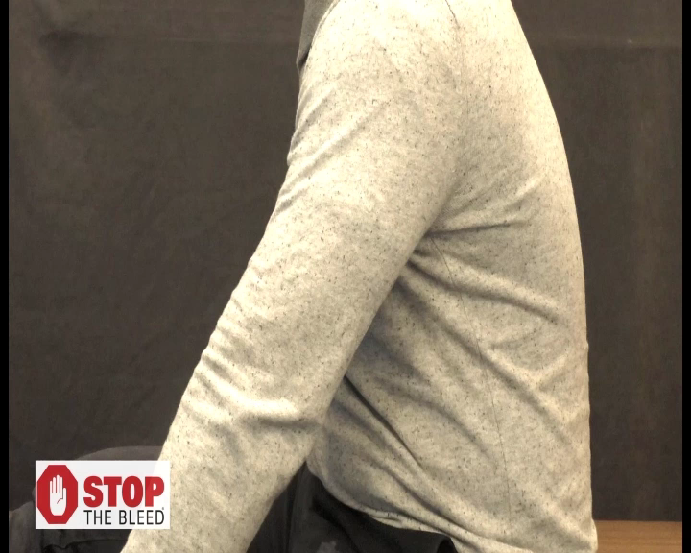
ABCs of Bleeding Control

Slide 25
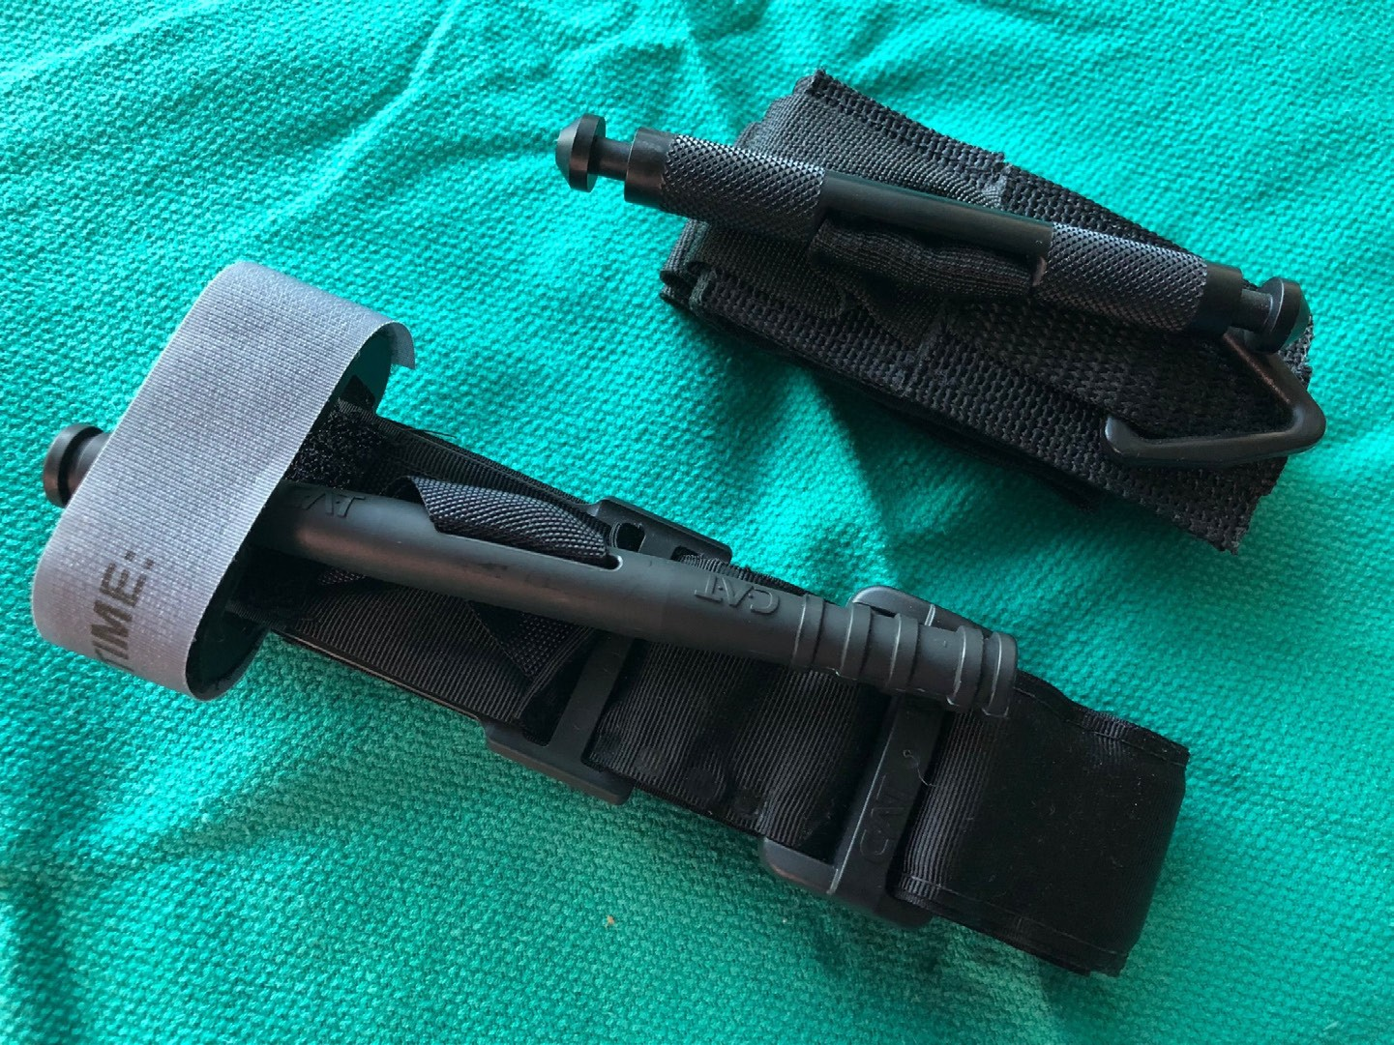
ABCs of Bleeding Control
SOFT-T
CAT

Slide 26
Bleeding control in children
In all but the extremely young child, the same tourniquet used for adults can be used in children.
For the infant or very small child (tourniquet too big), direct pressure on the wound as described previously will work in virtually all cases.
For large, deep wounds, wound packing can be performed in children just as in adults using the same technique as described previously.
Notes:
Techniques to control bleeding in the child are very similar to what has been presented for adults.
As long as they can be properly applied, the same tourniquet can be used in an adult or a child.
If the child is too small for the tourniquet to be applied properly, direct pressure on the bleeding wound will almost always work to control the bleeding.
Wound packing is the same in both adults and children.

Slide 27
FAQs
Impaled objects?
Improvised tourniquets?
Loss of arm or leg?
Pain?
Other questions?

Slide 28

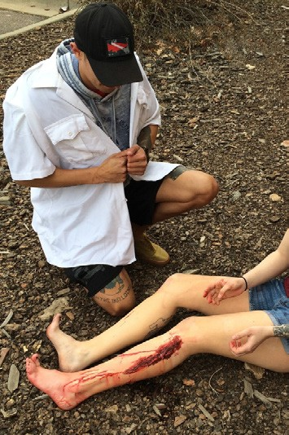
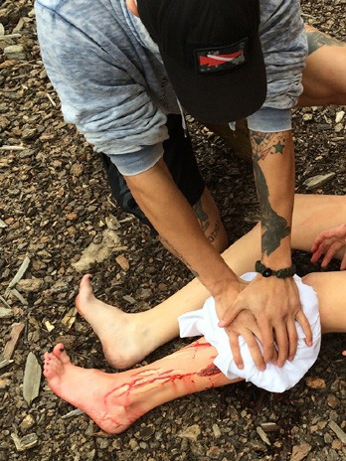
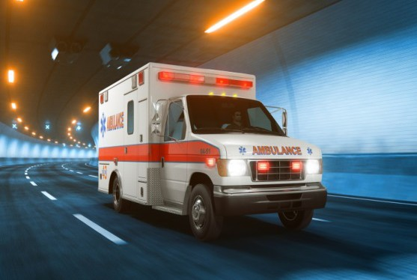
Summary
Personal safety A Alert 111
B Find bleeding C Compress with
pressure and/or packing
C Compress with a tourniquet
Wait for help to arrive

Slide 29
For more information:
BLEEDINGCONTROL.ORG

Slide 30
The only thing more tragic than a death… is a death that could have been prevented.
BLEEDINGCONTROL

